Slide 1
What is a Brownfield?
Region 8
Turning Eyesores into Assets: EPA Brownfields Resources
Ted Lanzano
June 15, 2022

Slide 2
What is a Brownfield?
Simple definition:
Property where real or perceived contamination is inhibiting its reuse.
Legal definition:
“...real property, the expansion, redevelopment, or reuse of which may be complicated by the presence or potential presence of a hazardous substance, pollutant, or contaminant.”
The Small Business Liability Relief and Brownfields Revitalization Act, signed January 11, 2002.
Region 8

Slide 3
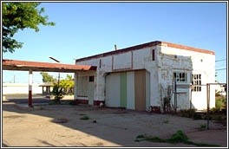
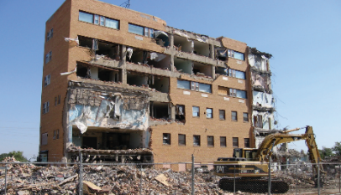
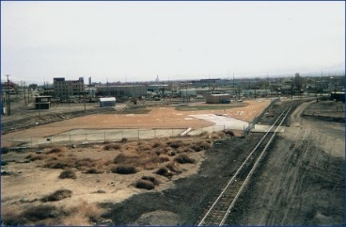
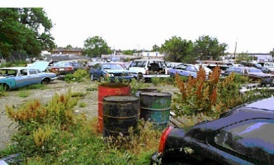
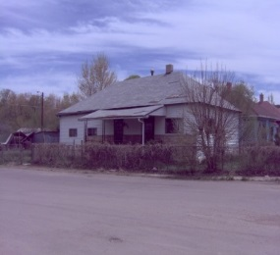
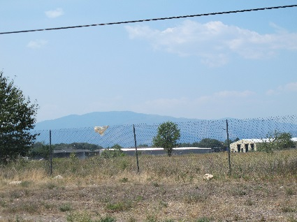
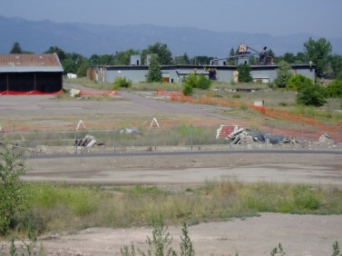
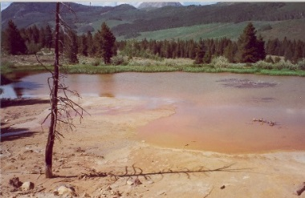
What is a Brownfield?
Gas stations
Buildings with asbestos
Properties near railroads
Scrapyards
Meth houses
Vacant lots
Sawmills
Mine scarred lands
Region 8

Slide 4
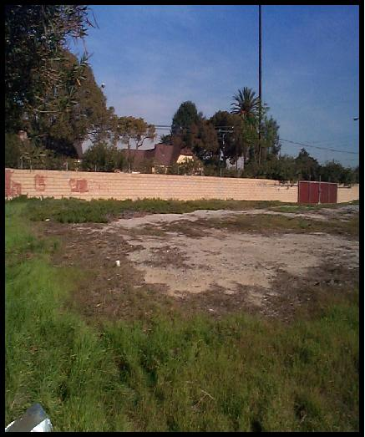
Our goal is not this…
Before
After
Region 8

Slide 5
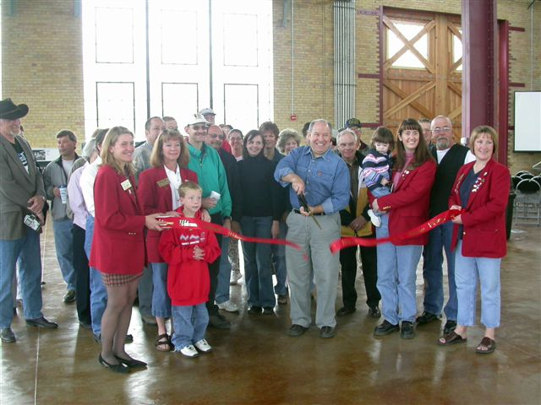
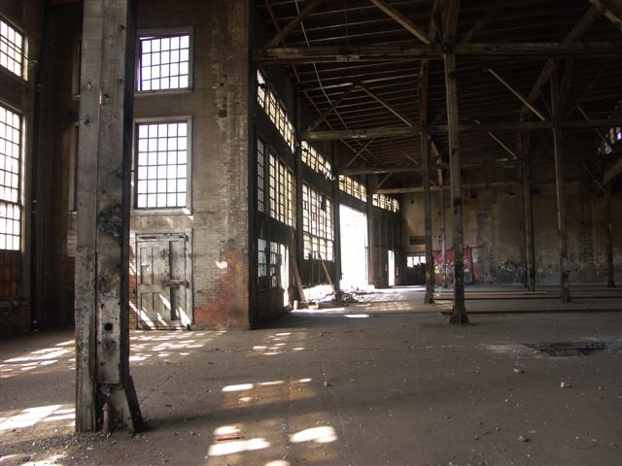
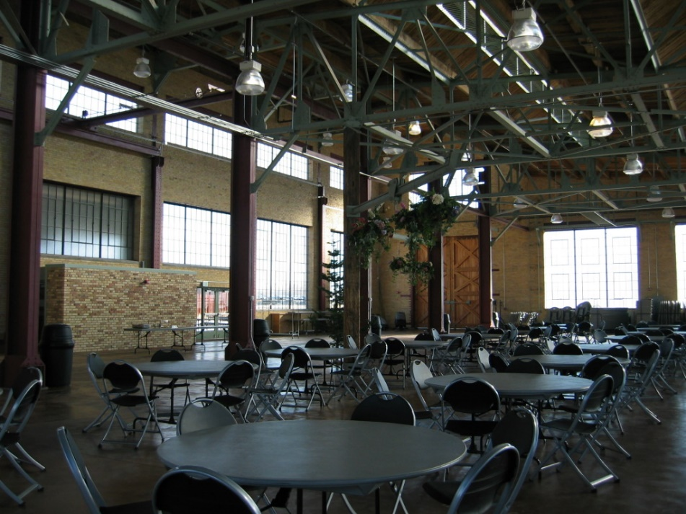
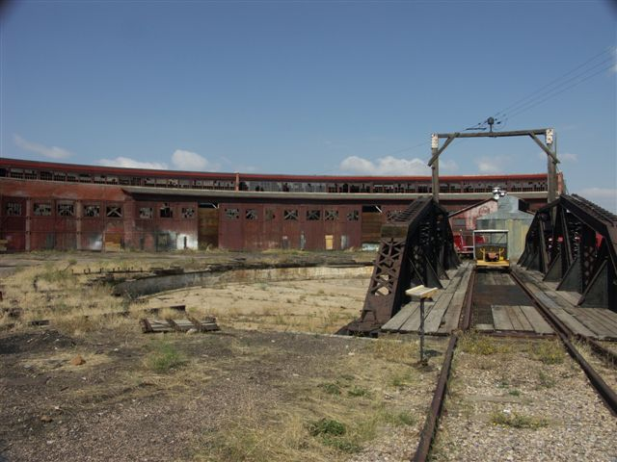
But rather this…
The restored Evanston Roundhouse
Before…
After…
Region 8

Slide 6
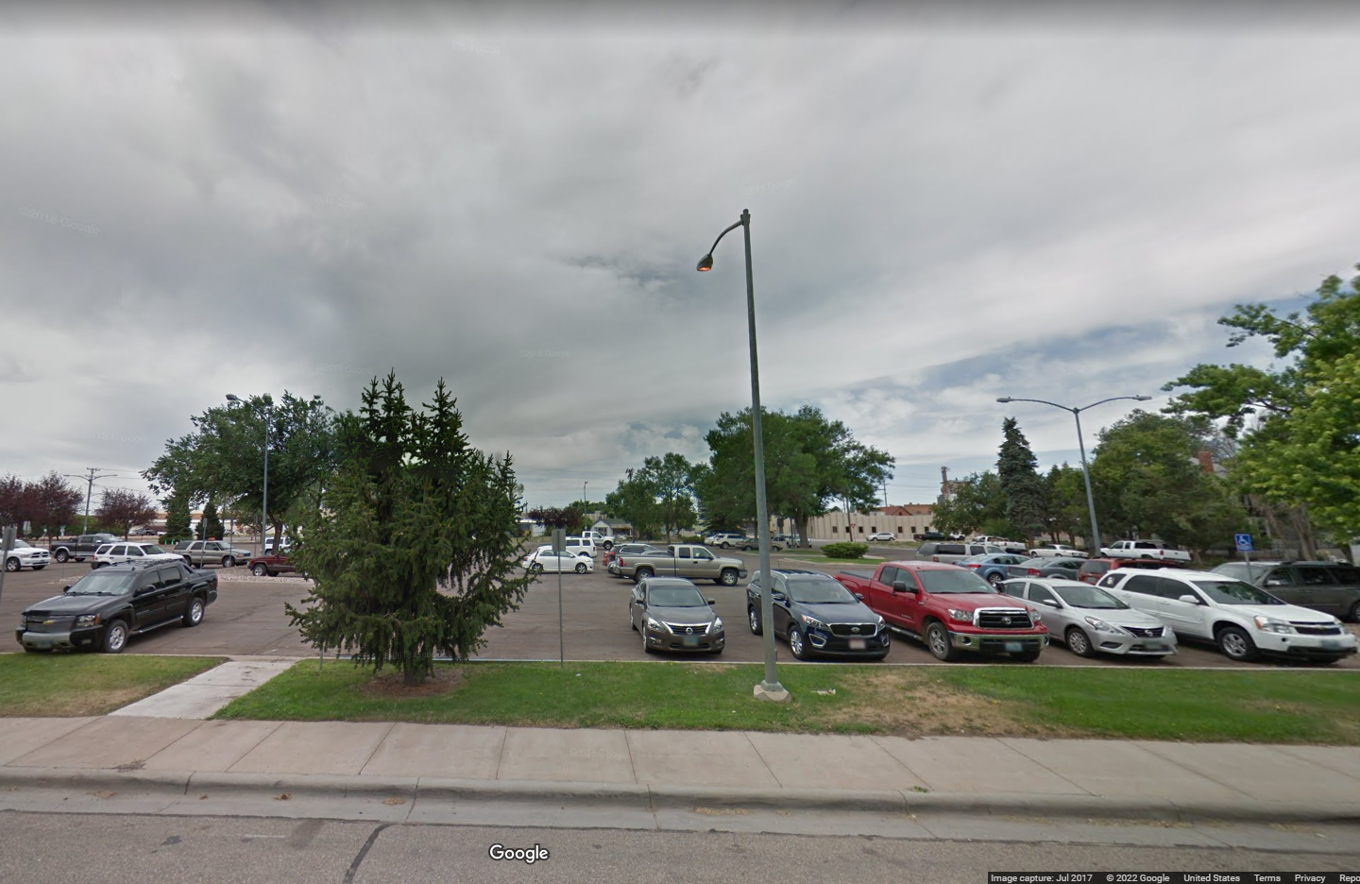
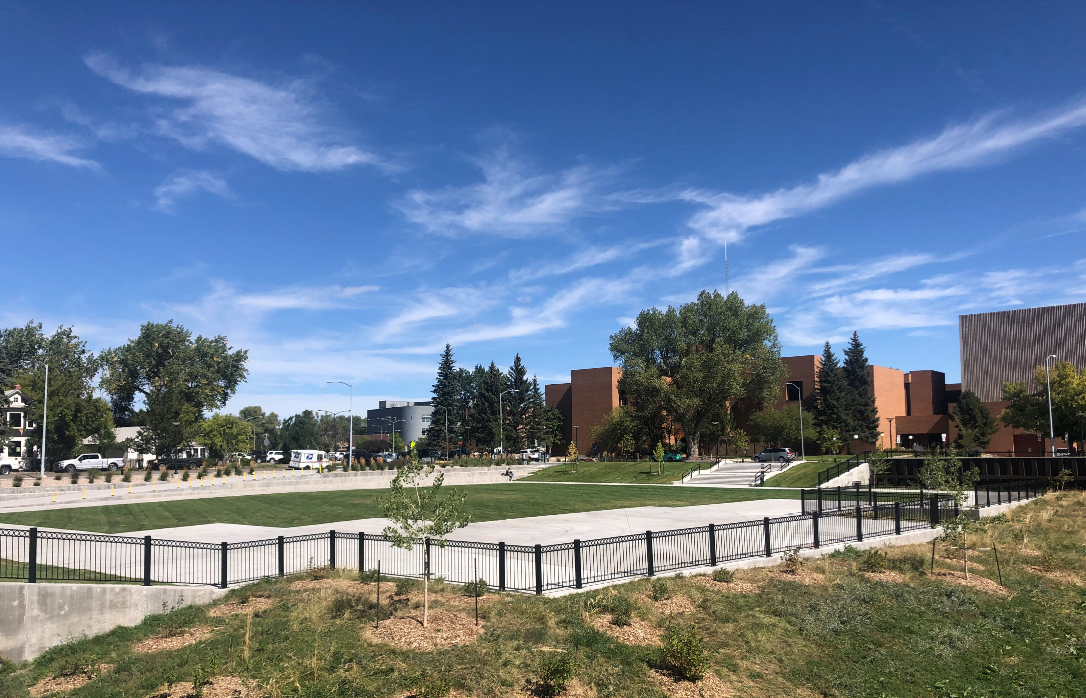
And this…
Before: city parking lot
After: Civic Commons Park
Region 8

Slide 7
Brownfields Grantees in Wyoming
City of Cheyenne
Community-wide Assessment
Revolving Loan Fund
Sheridan River Conservation District
Cleanup at former Acme Power Plant
Wyoming Business Council
Revolving Loan Fund
Wyoming DEQ
State-wide assessment
City of Douglas
Community-wide assessment
Past grantees: Cities of Casper, Green River, Laramie, Sheridan and many others!
Region 8

Slide 8
The Bipartisan Infrastructure Law
Provides $1.5 billion in additional Brownfields funding over the next five years.
$300 million each year, plus regular appropriations.
$ 1.2 billion in additional project grants over the next five years, plus $300 million to states and tribes
With the objective of creating 154,000 jobs and stimulating $30 billion in public/private funding
Region 8

Slide 9
Land Revitalization Technical Assistance
Assistance to help communities move forward with redevelopment of brownfields sites
Assistance includes:
Facilitation, community engagement and community visoning;
Market analyses and economic research;
Project financing
Site design and revitalization plans.
Region 8

Slide 10
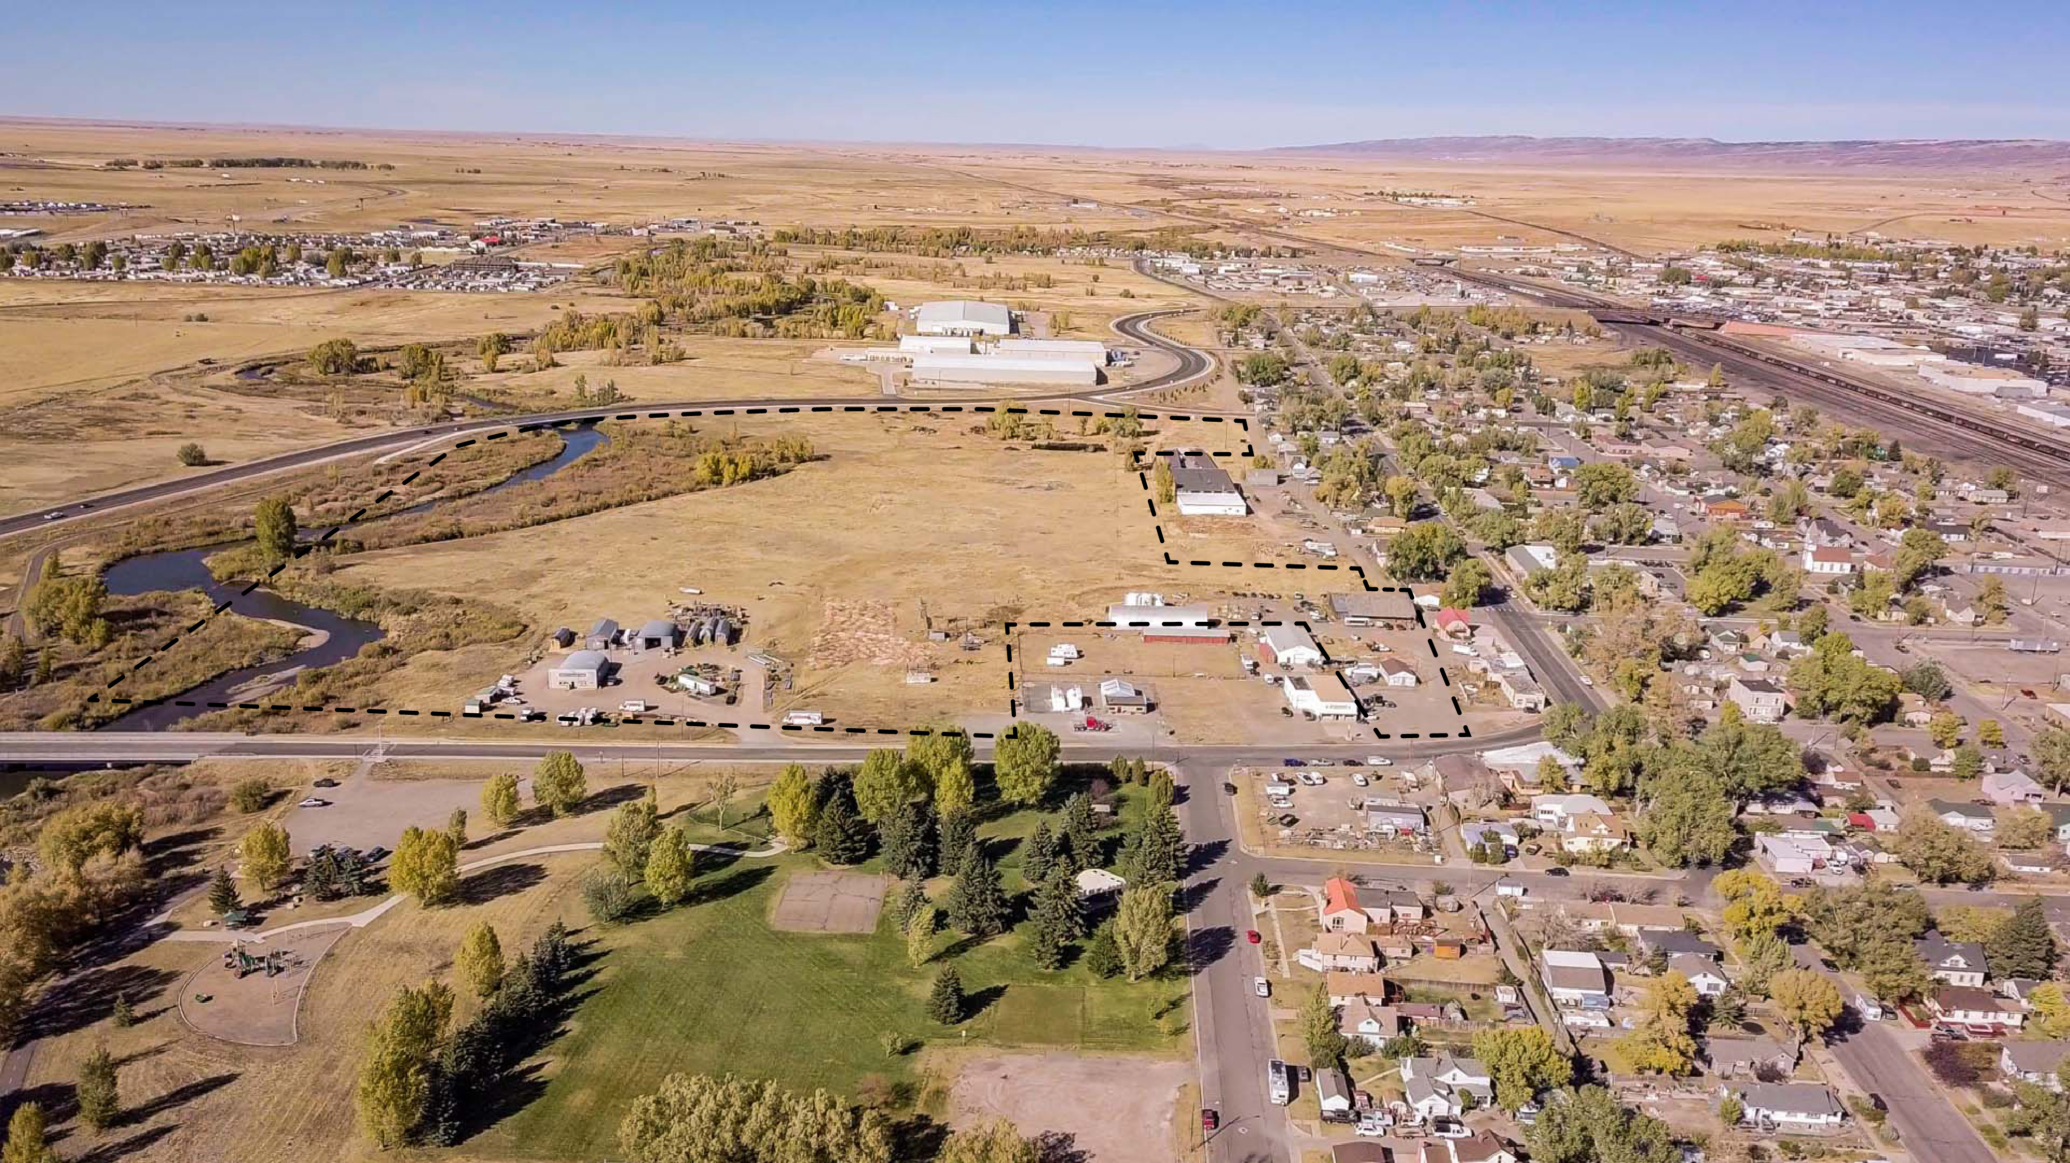
West Side Laramie Conceptual Redevelopment Plan
EPA Brownfields Technical Assistance Project

Slide 11
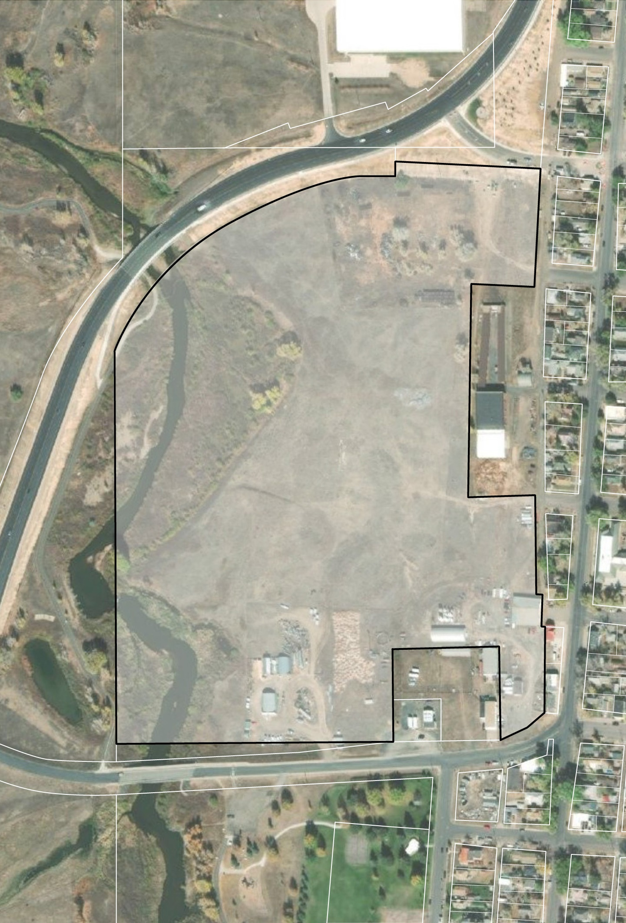
Background
West Laramie 4G Enterprise site covers 45.8 acres west of downtown Laramie
Site is currently privately owned
Former Union Pacific railyard
Site has undergone Phase I and Phase II Environmental Site Assessments
No significant environmental concerns that preclude future development

Slide 12
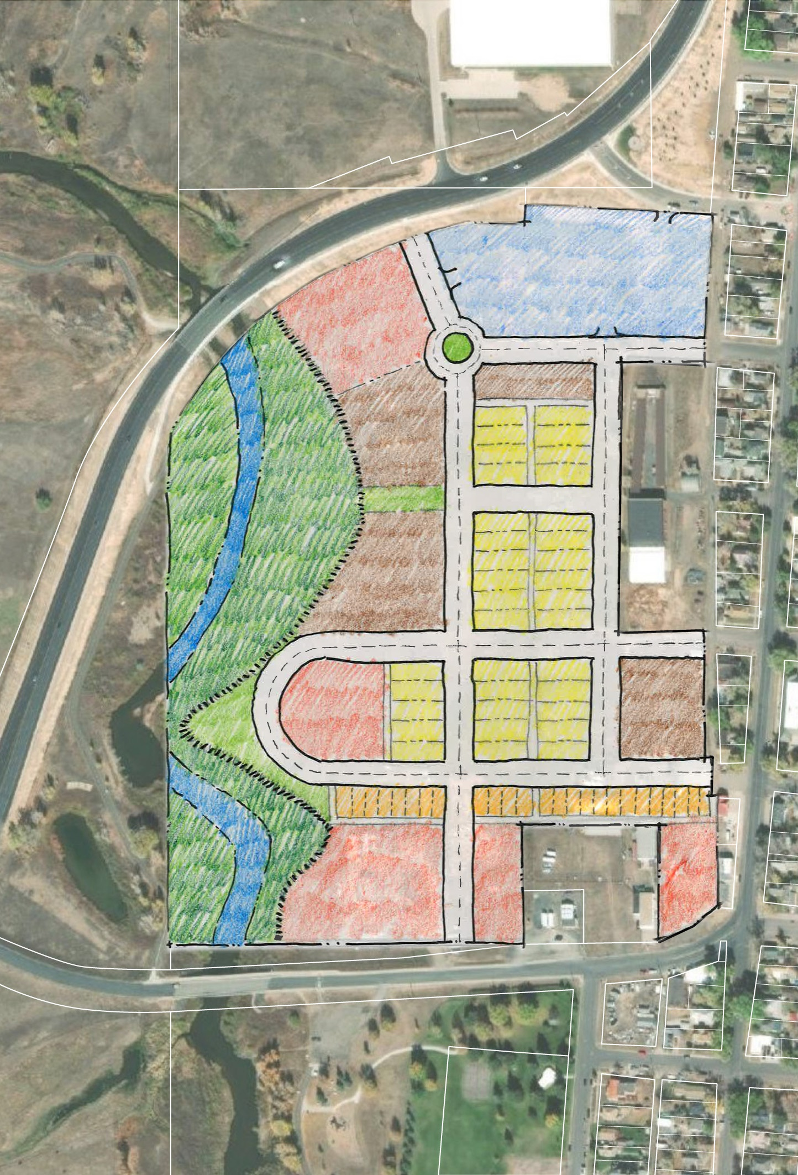
Alternative Framework A
Fremont Street
Continues existing street grid from West Side neighborhood
Includes more commercial development with additional mixed-use buildings
Curved road provides direct access down to riverbank
Traffic circle helps direct flow from Snowy Range Road to commercial district and south to housing
Snowy Range Road
Garfield Street
Mixed Use
Residential, Small Lot Single-Family
Residential, Mixed Density
Commercial
Residential, Apartments
Open Space

Slide 13
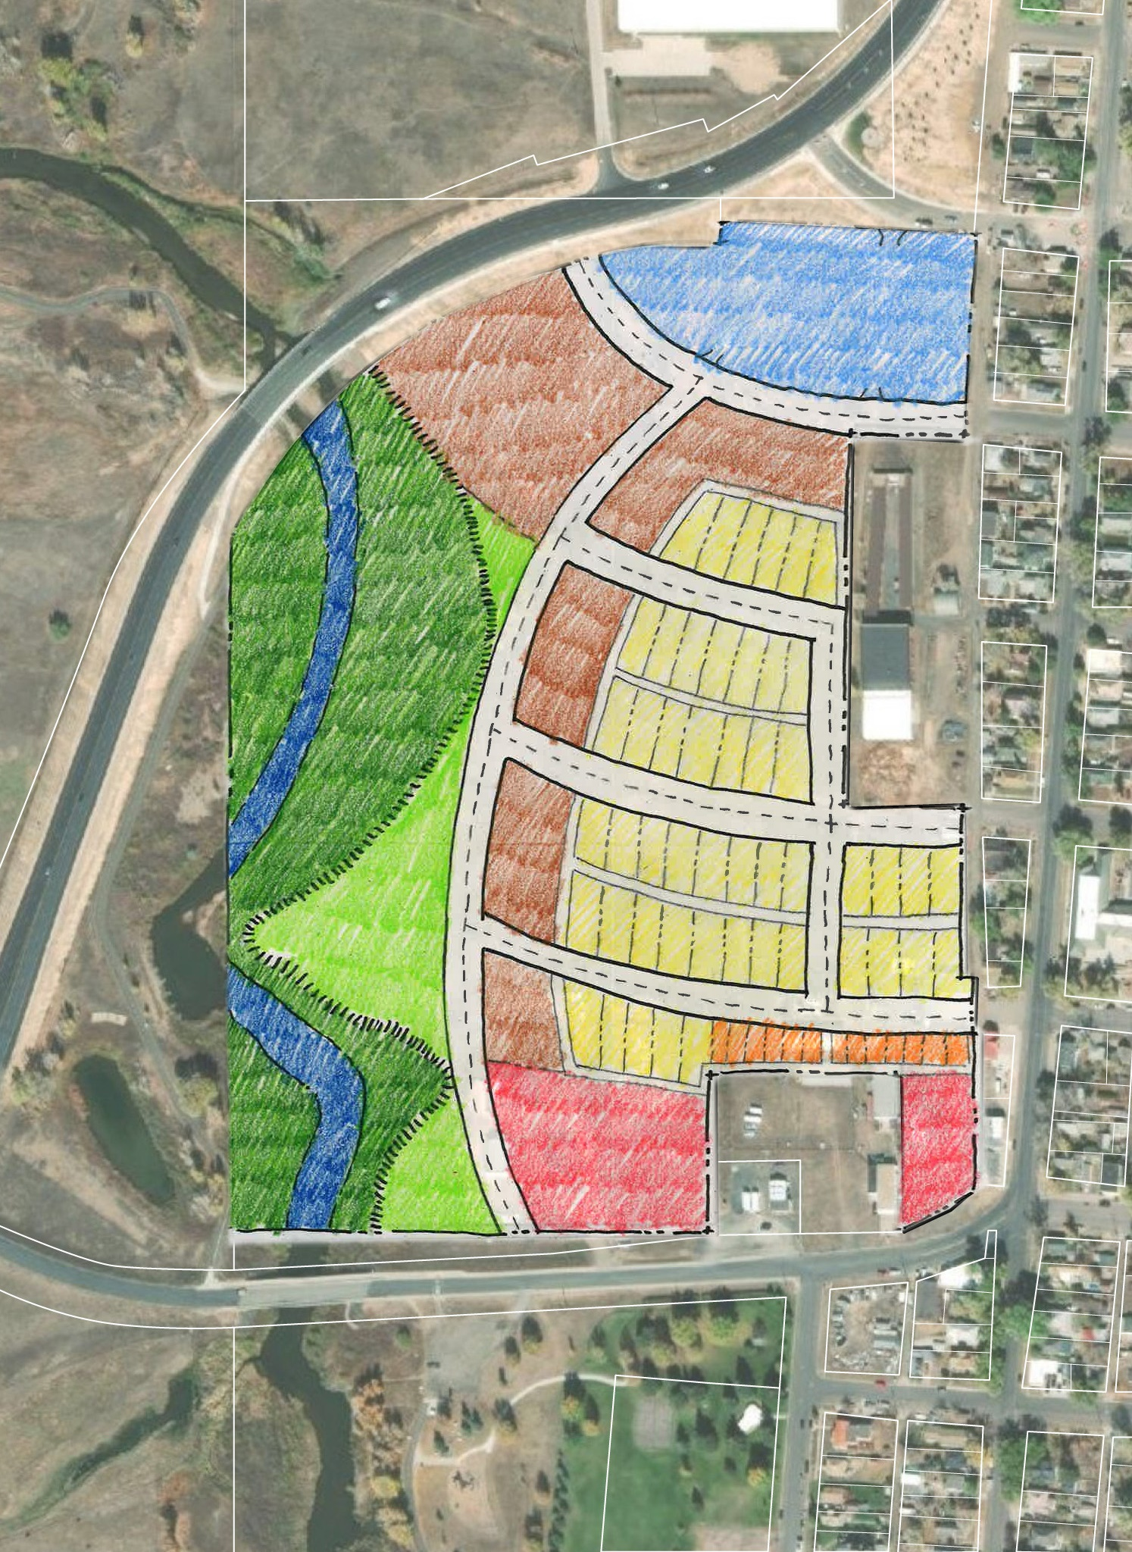
Alternative Framework B
Fremont Street
Curvilinear streets
Expanded open space by Laramie River
Emphasis on apartments and mid-density residential
Density of housing increases from east side of site adjacent to existing neighborhood across to the west
Snowy Range Road
Garfield Street
Mixed Use
Residential, Small Lot Single-Family
Residential, Mixed Density
Commercial
Residential, Apartments
Open Space

Slide 14
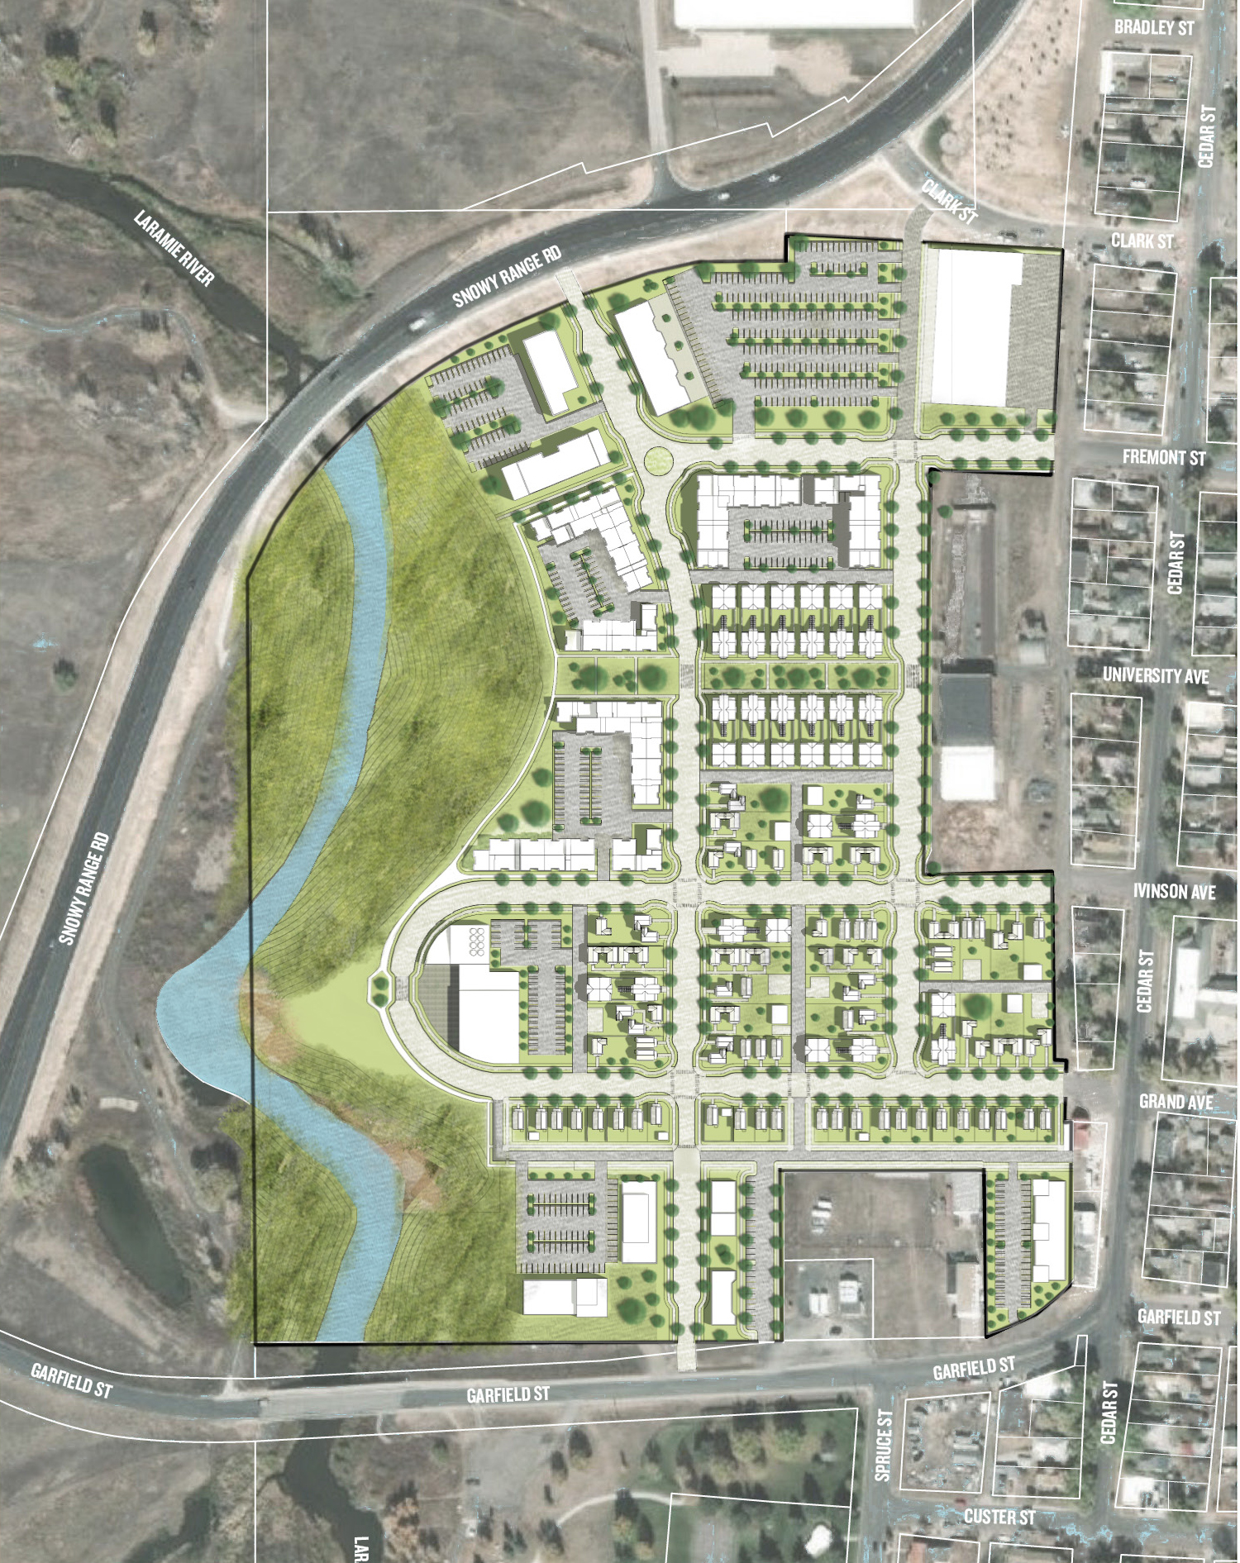
Final Conceptual Plan
340 Housing units across a mix of densities (single family, mixed-use, 3 story walkups, carriage houses)
7.4 dwelling units per acre
Includes a signature open space with integrated Green Streets and landscaped lanes to accommodate stormwater
Commercial development is distributed across the site in mixed-use and commercial districts

Slide 15
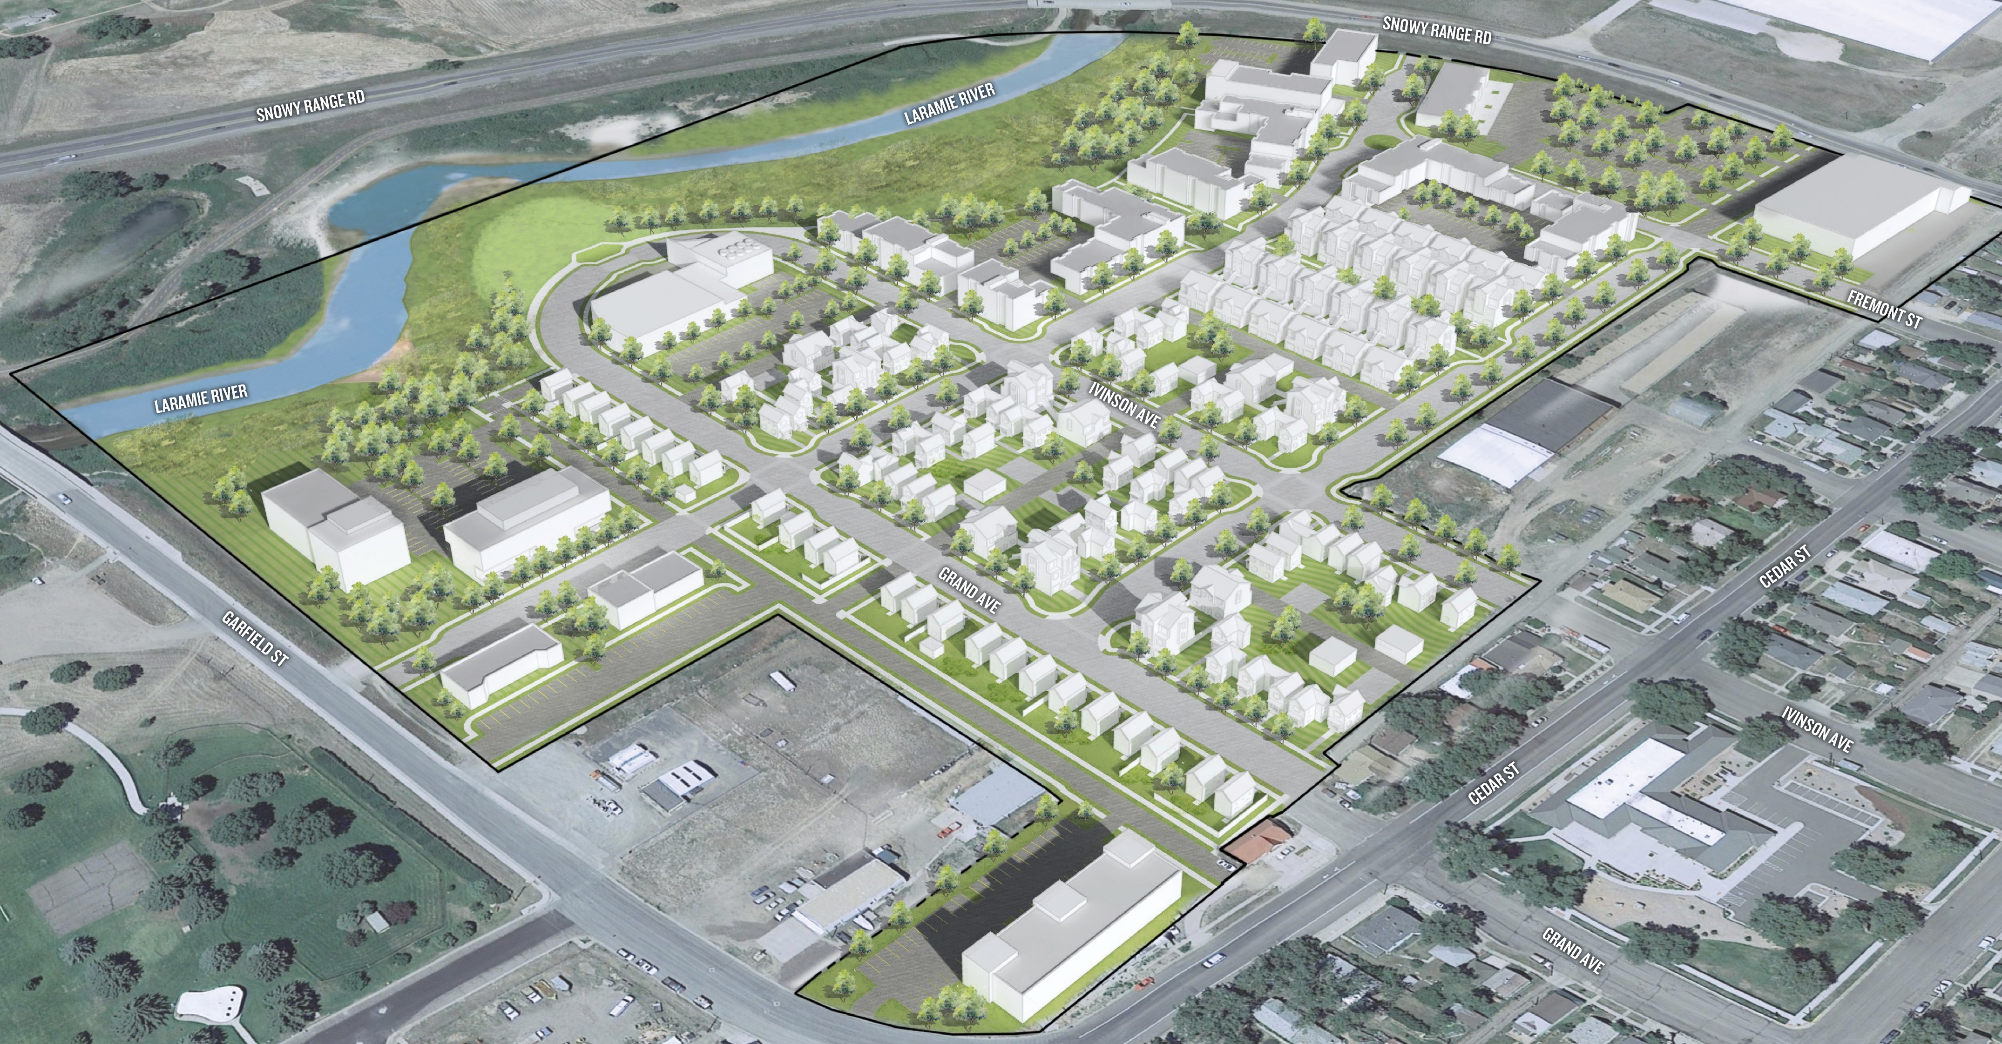
Proposed Development Mix
Typology | Number of Units/Square Footage (SF)
Residential (Single Family/Small Lot) | 24 Units (~ 840 SF – 1100 SF per unit)
Residential (Mixed Density) | 133 Units (~ 840 SF – 1600 SF per unit)
Residential (Apartments) | 172 Units (~ 650 – 990 SF per unit)
Commercial Space | 106,000 SF total

Slide 16
State Resources
Wyoming Business Council - Revolving Loan Fund
Low interest loans and grants for cleanup
Wyoming DEQ – environmental assessment support
Excellent support from both departments to discuss projects and how to move forward.
Region 8

Slide 17
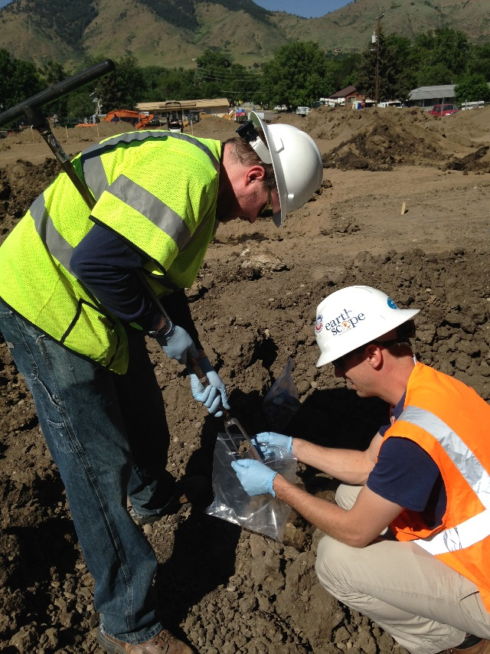
Targeted Brownfields Assessments (TBAs)
EPA assistance to communities by providing assessment support
Typical assistance consists of Phase I and II assessments and cleanup planning
Ongoing application process
Easy application!
TBAs conducted by EPA environmental consultants at no cost to communities.
Region 8

Slide 18
Brownfields Contacts
EPA: Ted Lanzano, EPA, lanzano.ted@epa.gov, (303) 819-6427
Wyoming DEQ: Cindi Martinez, Wyoming DEQ, cindi.martinez@wyo.gov
Wyoming Business Council: Justin Mabie, justin.mabie1@wyo.gov
Region 8

