Slide 1
FS4N
Fiscal Strategies 4 Nonprofits, LLC
SE4N
Sustainability Education 4 Nonprofits
Nonprofit Organization
Key Financial Management Components
September 29, 2022
Speaker: A. Michael Gellman, CPA, CGMA, CFSO
Fiscal Strategies 4 Nonprofits, LLC
Sustainability Education 4 Nonprofits
mgellman@fiscalstrategies4nonprofits.com
www.se4nonprofits.com www.fiscalstrategies4nonprofits.com

Slide 2
Learning Objectives
Part I
Behavior Based Budget Techniques
Case Study - #1
Other Critical Budget Considerations
In-Kind Contributions
Reserves
Part II
Form 990
The Basics
Telling
“The Good Story”
Ambassador
Top Ten Form 990 Page One Considerations
SE4N – Sustainability Education 4 Nonprofits
FS4N – Fiscal Strategies 4 Nonprofits, LLC

Slide 3
Part I Behavior Based Budget Techniques
SE4N – Sustainability Education 4 Nonprofits
FS4N – Fiscal Strategies 4 Nonprofits, LLC

Slide 4
Budgeting for Nonprofits
Adopt a:
User Based Budget Approach
SE4N – Sustainability Education 4 Nonprofits
FS4N – Fiscal Strategies 4 Nonprofits, LLC

Slide 5
WHAT’S WRONG WITH BUDGETS TODAY???
Conceptually
Budgets are most often viewed as an end product or as a static document
This view point is 180 degrees in the wrong direction
SE4N – Sustainability Education 4 Nonprofits
FS4N – Fiscal Strategies 4 Nonprofits, LLC

Slide 6
NEW PERSPECTIVE ON BUDGETING!!!
First Step
View budgeting backwards
Teach the importance of how to use a budget before how to build a budget
SE4N – Sustainability Education 4 Nonprofits
FS4N – Fiscal Strategies 4 Nonprofits, LLC

Slide 7
Glossary >>>> of Budget Terms
CONCEPTS
Use
Everyday
Simple
Understandable
A Tool for Improvement
TECHNICAL
Projections
Time is on Our Side
Raise Awareness
Change Behavior
Behavioral Based Budgeting
SE4N – Sustainability Education 4 Nonprofits
FS4N – Fiscal Strategies 4 Nonprofits, LLC

Slide 8
Financially – Are We OK???
Good Question to Ask Yourself
(Two Ways to Ask this Question)
SE4N – Sustainability Education 4 Nonprofits
FS4N – Fiscal Strategies 4 Nonprofits, LLC

Slide 9
Financially – Are We OK???
How Am { I } Doing?
(as a manager)
SE4N – Sustainability Education 4 Nonprofits
FS4N – Fiscal Strategies 4 Nonprofits, LLC

Slide 10
Financially – Are We OK???
More Importantly
How are { We } Doing?
(as an organization)
SE4N – Sustainability Education 4 Nonprofits
FS4N – Fiscal Strategies 4 Nonprofits, LLC

Slide 11
Financially – Are We OK???
To Answer the Question:
Goals are the KEY
Budgets are Critical to Managing Goals
SE4N – Sustainability Education 4 Nonprofits
FS4N – Fiscal Strategies 4 Nonprofits, LLC

Slide 12
Managing Through >>>> Financial Reports
This is How it Works:
Raise Awareness
Change Behavior
EQUALS =
Improved Bottom-line Results
SE4N – Sustainability Education 4 Nonprofits
FS4N – Fiscal Strategies 4 Nonprofits, LLC

Slide 13
Managing Through >>>> Financial Reports
Re-direct the Budget System to Gear it Towards:
EVERYDAY USE
SE4N – Sustainability Education 4 Nonprofits
FS4N – Fiscal Strategies 4 Nonprofits, LLC

Slide 14
Everyday Use >>>> Example
Let's Now Look at a Four-Part Budget Application Example
Individual Problem Solving
SE4N – Sustainability Education 4 Nonprofits
FS4N – Fiscal Strategies 4 Nonprofits, LLC

Slide 15
BUDGET EXAMPLE
15

Slide 16
BUDGET EXAMPLE
16

Slide 17
BUDGET EXAMPLE
17

Slide 18
BUDGET EXAMPLE
18

Slide 19
BUDGET EXAMPLE
19

Slide 20
BUDGET EXAMPLE
20

Slide 21
Budget >>>> Cycles
Budgets From Two Points of View:
Process View (traditional budget cycle)
Management View (working monthly cycle)
SE4N – Sustainability Education 4 Nonprofits
FS4N – Fiscal Strategies 4 Nonprofits, LLC

Slide 22
Budget >>>> Cycles
continued
Process View (budget cycle)
Preparation
Approval
Installation
Measurement
Projection
SE4N – Sustainability Education 4 Nonprofits
FS4N – Fiscal Strategies 4 Nonprofits, LLC

Slide 23
Budget >>>> Cycles
continued
Management View (monthly cycle)
Monitor
Feedback
Override
React
SE4N – Sustainability Education 4 Nonprofits
FS4N – Fiscal Strategies 4 Nonprofits, LLC

Slide 24
Results Through >>>> Financial Reports
Get:
EVERYONE INVOLVED
In the Budgeting Process
SE4N – Sustainability Education 4 Nonprofits
FS4N – Fiscal Strategies 4 Nonprofits, LLC

Slide 25
Results Through >>>> Financial Reports
BUDGETS,
NOT A DOCUMENT,
A PROCESS
SE4N – Sustainability Education 4 Nonprofits
FS4N – Fiscal Strategies 4 Nonprofits, LLC

Slide 26
Results Through >>>> Financial Reports
continued
Make Projections:
PART OF THE SYSTEM
SE4N – Sustainability Education 4 Nonprofits
FS4N – Fiscal Strategies 4 Nonprofits, LLC

Slide 27
Results Through >>>> Financial Reports
continued
Projections - The Magic
View Current Transactions in Terms of
Year-end Results
A Clearer Picture
Achieving Goals through Projections
How they Work
Projections are Flexible Budgets in Disguise
SE4N – Sustainability Education 4 Nonprofits
FS4N – Fiscal Strategies 4 Nonprofits, LLC

Slide 28
Results Through >>>> Financial Reports
continued
History - Has Its Place
What Role Does History Play
History is FREE
History Cannot be Changed
Is History a Direct Predictor of the Future
NO
Can be Misleading
SE4N – Sustainability Education 4 Nonprofits
FS4N – Fiscal Strategies 4 Nonprofits, LLC

Slide 29
Results Through >>>> Financial Reports
continued
Painting the Perfect Picture Through:
ENHANCED REPORT DESIGN
SE4N – Sustainability Education 4 Nonprofits
FS4N – Fiscal Strategies 4 Nonprofits, LLC

Slide 30
Results Through >>>> Financial Reports
continued
Time is the:
ENEMY
Put Time to Work
SE4N – Sustainability Education 4 Nonprofits
FS4N – Fiscal Strategies 4 Nonprofits, LLC

Slide 31
Results Through >>>> Financial Reports
continued
Political Bottom-Lines:
HAVE A STRATEGY
SE4N – Sustainability Education 4 Nonprofits
FS4N – Fiscal Strategies 4 Nonprofits, LLC

Slide 32
Results Through >>>> Financial Reports
continued
Do Not Forget the Three Secret Weapon:
Monthly Budgets
Projections
Contingency Budgets
SE4N – Sustainability Education 4 Nonprofits
FS4N – Fiscal Strategies 4 Nonprofits, LLC

Slide 33
Unlocking Results by USING Budgets
summary
The Goal: (for your Budget)
A WORKING Budget System
for EVERYDAY USE that
RAISES AWARENESS which
CHANGES Staff BEHAVIOR which
Equals = RESULTS
SE4N – Sustainability Education 4 Nonprofits
FS4N – Fiscal Strategies 4 Nonprofits, LLC

Slide 34
OTHER BUDGET CONSIDERATIONS
In-Kind Contributions
Indirect Costs/Allocation of Overhead
Contingency Budgets
Cash Flow Considerations and Reports
Forecasting Methods
SE4N – Sustainability Education 4 Nonprofits
FS4N – Fiscal Strategies 4 Nonprofits, LLC

Slide 35
OTHER BUDGET CONSIDERATIONS
Reporting to Boards – Dashboards
Operating Reserves
Budgets and Link to Strategic Plans
Budgeting for Grants and Awards
Capital Budgets
Budgeting for Salaries
SE4N – Sustainability Education 4 Nonprofits
FS4N – Fiscal Strategies 4 Nonprofits, LLC

Slide 36
Part II Form 990 “Telling the Good Story” Megaphone for Pride and Accomplishment
SE4N – Sustainability Education 4 Nonprofits
FS4N – Fiscal Strategies 4 Nonprofits, LLC

Slide 37
Purpose of 990
IRS informational return to help assure that exempt organizations are in compliance and following best practices
Moreover, a public document used by:
State regulators (attorneys general)
Granting organizations and contributors
Watchdog and Charity Rating organizations
The Press (especially useful for digging dirt!)
Anyone who wants to look at you!
Available on the internet at guidestar.org
SE4N – Sustainability Education 4 Nonprofits
FS4N – Fiscal Strategies 4 Nonprofits, LLC

Slide 38
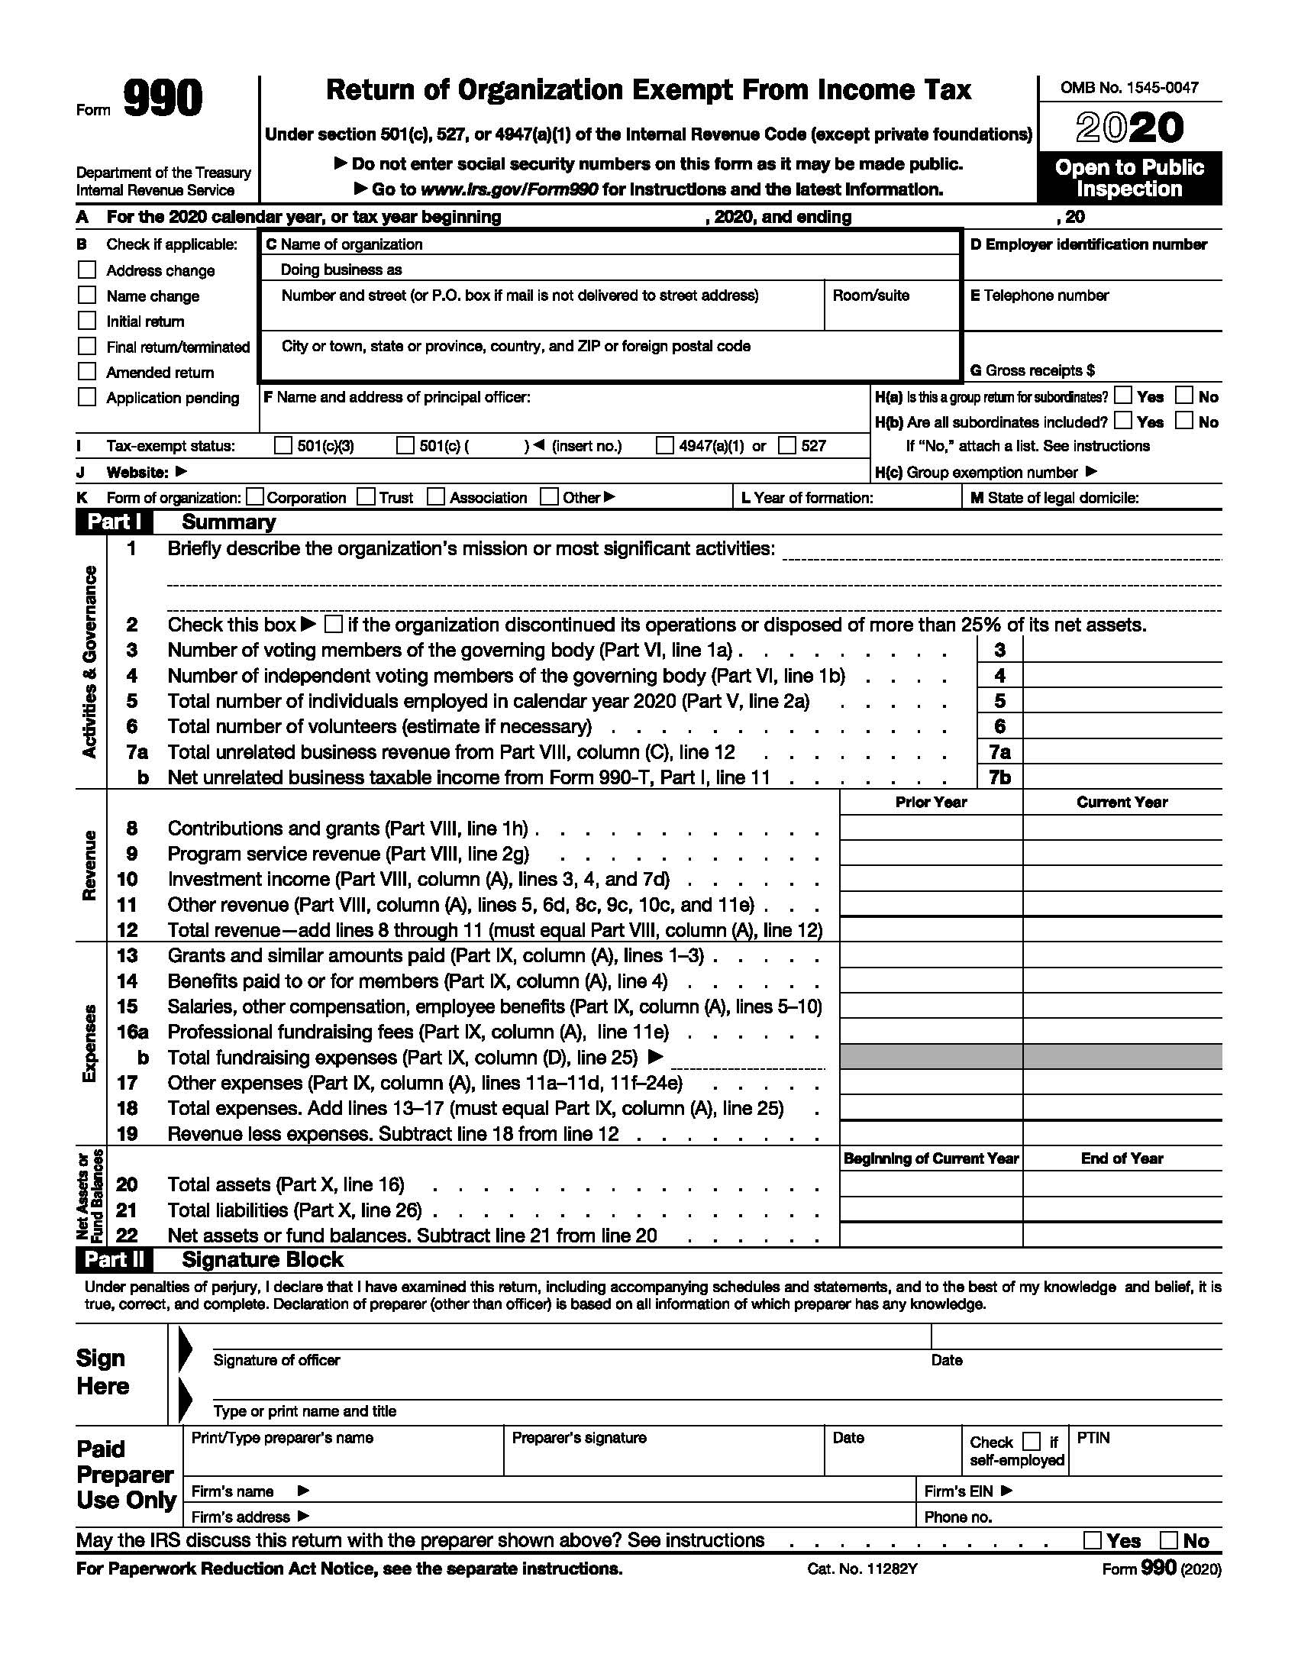
Form 990 is your opportunity to –
Showcase your organization
Brag about your accomplishments
Talk about what’s “new”
Call attention to your programs and activities
SE4N – Sustainability Education 4 Nonprofits
FS4N – Fiscal Strategies 4 Nonprofits, LLC

Slide 39
Form 990 can be the ambassador for your organization
Telling a story that is –
Complete
Confident
Compelling
SE4N – Sustainability Education 4 Nonprofits
FS4N – Fiscal Strategies 4 Nonprofits, LLC

Slide 40
Your Complete Story
Paints a broad picture of
Mission
Activities
Programs
Infrastructure
Financials
SE4N – Sustainability Education 4 Nonprofits
FS4N – Fiscal Strategies 4 Nonprofits, LLC

Slide 41
Your Confident Story
Paints a broad picture of
Compliance
Best Practices
Financial Strength (or lack thereof)
Fundraising
Audits
Organizational Longevity
SE4N – Sustainability Education 4 Nonprofits
FS4N – Fiscal Strategies 4 Nonprofits, LLC

Slide 42
Your Compelling Story
Paints a broad picture of
Mission Impact
Support and Revenue Activities
Volunteers (including Board Members)
Brand Recognition and Trust
SE4N – Sustainability Education 4 Nonprofits
FS4N – Fiscal Strategies 4 Nonprofits, LLC

Slide 43
Form 990 is a window to your organization
It’s all about that initial impression
You only have 60 seconds
Page 1 is your key to success
SE4N – Sustainability Education 4 Nonprofits
FS4N – Fiscal Strategies 4 Nonprofits, LLC

Slide 44
Ten Impactful Page 1 Strategies –
Get the Name and Address “Right”
Principal Officer
Year of Formation
Mission and Significant Activities
Board Member Independence
Total Number of Individuals Employed
Volunteers
Optics of Showing Support and Revenue
Professional Fundraising Fees/Total Fundraising Expenses
The Signature from your Organization
SE4N – Sustainability Education 4 Nonprofits
FS4N – Fiscal Strategies 4 Nonprofits, LLC

Slide 45
Get the Name and Address Right
Legal Name
DBA (Doing Business As)
Address
SE4N – Sustainability Education 4 Nonprofits
FS4N – Fiscal Strategies 4 Nonprofits, LLC

Slide 46
Principal Officer
What are the options?
The optics
Consistency
Ownership v Responsibility
What about the address?
SE4N – Sustainability Education 4 Nonprofits
FS4N – Fiscal Strategies 4 Nonprofits, LLC

Slide 47
Year of Formation
Consider the beginning: Is it correct?
What is the history and origin
Schedule O to explain history
SE4N – Sustainability Education 4 Nonprofits
FS4N – Fiscal Strategies 4 Nonprofits, LLC

Slide 48
Mission and Significant Activities
Three opportunities to list on Form 990
Page 1 – Short and impactful
Page 2 – Formal mission statement
Sch. O – Complete mission description
SE4N – Sustainability Education 4 Nonprofits
FS4N – Fiscal Strategies 4 Nonprofits, LLC

Slide 49
Board Member Independence
Number of voting members
Number of independent voting members
What if Lines 3 and 4 are different?
SE4N – Sustainability Education 4 Nonprofits
FS4N – Fiscal Strategies 4 Nonprofits, LLC

Slide 50
Total Number of Individuals Employed
W-2 based
Fiscal Year vs. Calendar
Staff turnover
Interns & Temporary Workers
SE4N – Sustainability Education 4 Nonprofits
FS4N – Fiscal Strategies 4 Nonprofits, LLC

Slide 51
Total Number of Volunteers
Who is a volunteer?
Documentation and record keeping
SE4N – Sustainability Education 4 Nonprofits
FS4N – Fiscal Strategies 4 Nonprofits, LLC

Slide 52
Optics of Showing Support and Revenue
Contributions, gifts, grants, etc.
Program service revenue
Are You Satisfied With the Presentation?
SE4N – Sustainability Education 4 Nonprofits
FS4N – Fiscal Strategies 4 Nonprofits, LLC

Slide 53
Professional Fundraising Fees/Total Fundraising Expenses
What are we disclosing?
Why does it matter?
SE4N – Sustainability Education 4 Nonprofits
FS4N – Fiscal Strategies 4 Nonprofits, LLC

Slide 54
Signature of Your Organization
Consider alignment with Principal Officer
Ownership and Responsibility
SE4N – Sustainability Education 4 Nonprofits
FS4N – Fiscal Strategies 4 Nonprofits, LLC

Slide 55
Other Considerations in Form 990
that Do Not Impact Page 1
But are Highly Visible and Attract Great Attention
SE4N – Sustainability Education 4 Nonprofits
FS4N – Fiscal Strategies 4 Nonprofits, LLC

Slide 56
The search for perfection and getting it –
Right: Compliance
Understandable: Disclosure
On Message: Mission, Brand Statement & Messaging
The challenge lies on pages –
Page 2 – Statement of Program Service Accomplishments
Page 6 – Governance Management Disclosures
Page 7 - Compensation
SE4N – Sustainability Education 4 Nonprofits
FS4N – Fiscal Strategies 4 Nonprofits, LLC

Slide 57
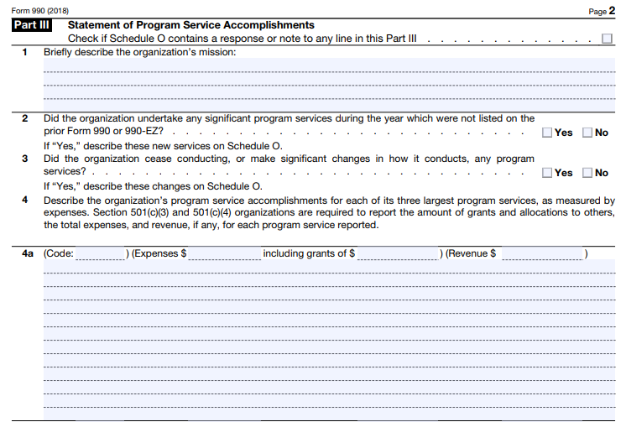
Statement of Program Service Accomplishments
Briefly describe the organization’s mission
Significant program activities not listed last year
Significant changes or cessations of programs
Three largest programs and their accomplishments
SE4N – Sustainability Education 4 Nonprofits
FS4N – Fiscal Strategies 4 Nonprofits, LLC

Slide 58
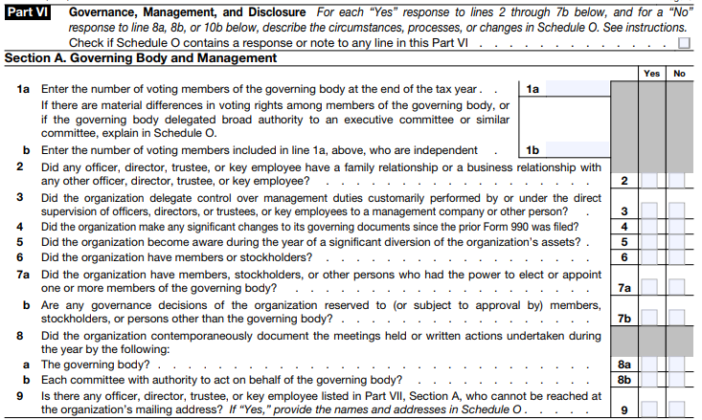
Governing Body & Management
Voting & independent board
Delegation of management
Significant changes to governing documents
Significant diversion of assets
Documentation of meetings
Hard to reach board members and employees
SE4N – Sustainability Education 4 Nonprofits
FS4N – Fiscal Strategies 4 Nonprofits, LLC

Slide 59
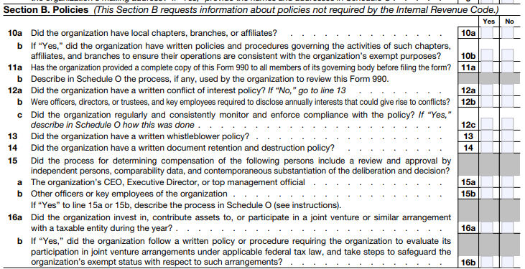
Policies
Chapters, branches, etc.
Form 990 review process
Conflict of interest
Whistleblower
Document retention & destruction
Compensation review
Joint venture
SE4N – Sustainability Education 4 Nonprofits
FS4N – Fiscal Strategies 4 Nonprofits, LLC

Slide 60
Disclosure
States where we file our 990
Public inspection requirement
Other publicly available information
Person in possession of our books and records
SE4N – Sustainability Education 4 Nonprofits
FS4N – Fiscal Strategies 4 Nonprofits, LLC

Slide 61
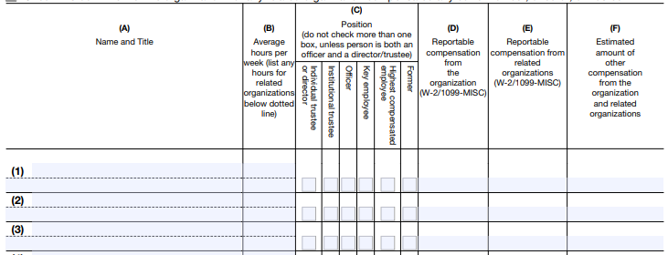
Compensation
Who should be listed?
What am I?
Average hours per week
Remuneration (aka the gossip columns)
SE4N – Sustainability Education 4 Nonprofits
FS4N – Fiscal Strategies 4 Nonprofits, LLC

Slide 62
Part VII, Section A Officers, Directors, Trustees, Key Employees and Highest Compensated Employees
To be included:
All current officers, directors, and trustees regardless of compensation level
All key employees who received reportable compensation greater than $150,000
The organization’s five current highest compensated employees (other than current officers, directors and key employees) who received reportable compensation of more than $100,000
All former officers and key employees who received more than $100,000
Former directors and trustees that received, in the capacity of a former director or trustee, more than $10,000
SE4N – Sustainability Education 4 Nonprofits
FS4N – Fiscal Strategies 4 Nonprofits, LLC

Slide 63
Part VII, Section A, continued
Information to be provided:
Name and title
Average hours per week
Position (check all that apply as listed on the form)
Reportable compensation from the organization (W-2/1099-MISC)
Reportable compensation from related organizations (W-2/1099-MISC)
Estimated amount of other compensation from the organization and related organizations
SE4N – Sustainability Education 4 Nonprofits
FS4N – Fiscal Strategies 4 Nonprofits, LLC

Slide 64
Independent Contractors
Five highest compensated contractors
Total number of contractors
SE4N – Sustainability Education 4 Nonprofits
FS4N – Fiscal Strategies 4 Nonprofits, LLC

Slide 65
Does your Form 990 –
Tell a good, strong story?
Complete
Confident
Compelling
Make a Good First Impression?
Megaphone for Pride and Accomplishment?
SE4N – Sustainability Education 4 Nonprofits
FS4N – Fiscal Strategies 4 Nonprofits, LLC

Slide 66
FS4N
Fiscal Strategies 4 Nonprofits, LLC
SE4N
Sustainability Education 4 Nonprofits
Nonprofit Organization
Key Financial Management Components
September 29, 2022
Speaker: A. Michael Gellman, CPA, CGMA, CFSO
Fiscal Strategies 4 Nonprofits, LLC
Sustainability Education 4 Nonprofits
mgellman@fiscalstrategies4nonprofits.com
www.se4nonprofits.com www.fiscalstrategies4nonprofits.com

