Slide 2
Notes:
We like to think of economic development as “Building Blocks”. Each block in the foundation supports subsequent blocks. Obviously, the more stable the base, the more stable the economic development program.
As you scan the block titles, you can readily see that economic development is much more than financing businesses … it’s building a community to support and grow business.

Slide 3
Notes:
All economic development starts with the desire of local people to improve their economic conditions. The dissatisfaction with “the way things are” becomes the catalyst for communities to face their problems. A basic premise to all economic development work is that when people agree on the problem, and see that they can benefit from solving the problem, it is easy to gain their support and investment toward a solution.
Local leadership and the implementation of supporting policy is the core building block of economic development. It is upon this foundation that a strong program can be built.

Slide 4
Notes:
True leadership and the development of public policy begins at the local level. This means providing opportunities for elected leaders and those leading civic organizations the opportunity to learn and gain experience in leadership. It also requires leaders to gain a deeper understanding of community and economic development.

Slide 5
Notes:
Leadership in economic development starts at the local level in our town halls and commissioner board rooms. It’s those local leaders who provide the support and approval for project work.
On the state level, we require the support for programs and serves provide the core tools which allow our projects to be successful. The same is true for federal programs which may also be a player.
As we currently see in Wyoming, our state and federal leadership honed their skills locally as members of city government and of local civic groups before taking their skills to a larger arena. It is that understanding of the local need that helps them succeed in the development of state and federal policy.
WEDA members work to keep their local elected official up to speed on economic development activities. WEDA works on a statewide level to provide information which help to shape the policies and programs which empower our communities.

Slide 6
Wyoming Economic Development Association (WEDA) provides leadership and support to foster economic development in Wyoming.
We do that in two ways:
Develop skilled economic development practitioners in Wyoming
Educate leadership regarding the impact of economic development to maintain the programs and services which help us do
our job.
Notes:
WEDA’s mission is to support its members and it does so by providing training for members on topics related to “building blocks.” We also provide support to grow the “tools” which economic developers use to grow their communities.
A key outcome of our training conferences is a more skilled and capable leader for local economic development efforts.

Slide 7
Notes:
One of the greatest success measures of community is the quality of life it affords it’s citizens. Because the people of every community are different, the quality of life is different as well. How we design our vision, goals and policy in a community directly impact the quality of life component.
Obviously, our natural environment also helps shape the quality of life as well. Savvy communities tie their community and its area attractions together to differentiate themselves from others. In Wyoming, we can easily say, Why live where you work? Why not work where you want to live?”

Slide 8
Notes:
Wyoming communities are blessed with excellent public facilities. You have to travel pretty far to see the consistent quality of schools, hospitals, libraries, parks and local government offices. It is these quality investments that make Wyoming unique.
Add to that the amazing diversity of outdoor recreation. Whether you hunt or fish, hike or climb, you’ll find your niche here.

Slide 9
Our Key WY Business Council Programs:
Community Facilities Program (CFP)
Community Enhancement Program
Community Development Block
Grants (CDBG)
These programs help your communities create community gathering spaces, and recreational and educational amenities, which promote a positive business climate in your home towns.

Slide 10
Notes:
The driving force behind our economy is the quality of our workforce and it’s ability to turn a profit for their companies. Workforce is a direct result of education and ethic; having the basic knowledge of how to do a task coupled with the willingness to see it through.
Our communities are built upon the skills and capability of those who live in the community and the support these foundational principles.
A quality workforce is not only important to existing business, it is a key to success in recruiting new companies. A relocation expert indicates that 5 of the top ten factors used in site selection are criteria related to workforce.
A key tool for very economic development program in Wyoming is the Department of Workforce Service’s Workforce Development Training Fund. These funds enable local companies to gain the needed skills and capabilities to grow and expand.

Slide 11
Notes:
Wyoming’s post secondary education system offers instruction from certificate programs to Doctoral degrees. With one university and 9 community colleges working as a unit, the educational opportunities are unlimited statewide …. and close to home. The community colleges provide an excellent local partner for expanding and enhancing job skills for workers.
Our state leaders see this importance and have provided excellent financial tools to provide better skills for new and existing workers. These grant programs are an excellent springboard for enhancing productivity.

Slide 12
Wyoming’s workforce relies upon the Department of Workforce Service’s Workforce Training Fund
This program is used repeatedly by Wyoming citizens and businesses to improve their skill sets to become more attractive to relocating businesses requiring a trained workforce.

Slide 13
Notes:
The days of a vacant field being deemed an “industrial park” are over. Communities must be prepared to put forth property, ready to build in order to successfully recruit companies.
For economic developers, available space is market potential. It is our primary job creation tool. It’s what we have to “sell”!
A filled building or fully built out business park is USELESS for economic development.

Slide 14
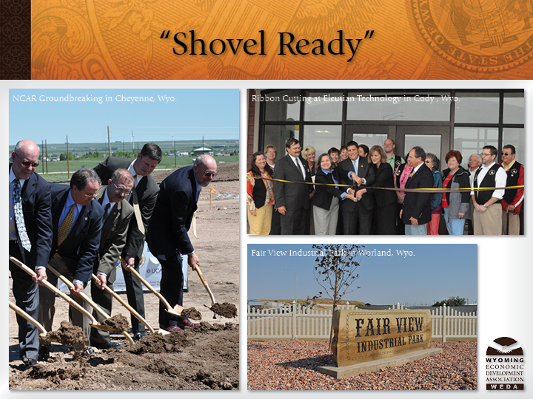
Notes:
Economic developers used to believe that the raw land on the fringe of the community was “industrial”. That is no longer the case. Businesses seeking to expand need infrastructure including water, sewer, power, natural gas and telecommunications. Communities that are “shovel ready” are really ready for good economic development.
Once again, our state leaders understand and have provided great funding programs to assist local site development.

Slide 15
A key tool in our tool kit:
WY Business Council –
Business Ready Communities Program (BRC)
This program builds the infrastructure needed to attract and grow both existing and new business.
Notes:
The Wyoming Business Council’s Business Ready Communities Program sets the stage for positive growth in our communities. The use of these funds across Wyoming enabled projects such as NCAR and Eleutian Technology to happen. Communities who did not have true “shovel ready sites ... Now do, and are ready for business.

Slide 16
Notes:
While it is tempting for economic developers to focus on the new and exciting relocation leads, the nuts and bolts of economic development reside in the businesses we already have. Many try to focus on the “big splashes” in our economy. As you see in the stats, 50 – 80% of job creation is within the existing core businesses in your community.
It makes sense as well. Each new job you create in an existing business, doesn’t require more public infrastructure, more traffic or more housing. Typically, this job growth draws employees from within the current job pool, helping employees to improve their earnings and enhance their lives.

Slide 17
Notes:
Every community has it’s share of businesses which serve as the economic drivers of the community. As these businesses grow and expand, a ripple of economic benefit is felt throughout the community. Smart communities look at their core industry, analyze the best ways to grow upon their strength.
These same communities will also seek ways to diversify their economy in order to smooth out seasonal variations.

Slide 18
Wyoming’s banner economic development
projects historically rely on these key programs:
Planning information from WY Business Council
Statistics from Workforce Development /Labor
Infrastructure Grants from WY Business Council
Workforce Training Grants from Dept. of Workforce Services

Slide 19
Notes:
What would America be without entrepreneurs? Our entire economic system has been built on the backs of people who dreamed of a better way, and then made it happen!
An economic development program provides a gateway for entrepreneurs to learn about the many resources available to start their businesses. Whether the product or service has a local or global market, the key is the circulation of dollars within the community.

Slide 20
Notes:
Wyoming is filled with examples of individuals who took an idea and with hard work, patience and a dose of stick-to-itiveness were able to develop great companies. These companies thrive on the quality lifestyle, infrastructure and business friendly nature of the State of Wyoming.
The local hands on assistance provided by WEDA Members across the state link these business people to the programs and services which are needed to grow Wyoming.

Slide 21
Notes:
Relocating new businesses is the big splash in economic development. It’s what everyone wants to see in the headlines. It’s what many people have come to expect. But as stated, it’s part of a successful program, not the whole program. Positioned at the top of the pyramid also implies that it takes successes at all levels before it works and that is true as well. If the total economic development program is solid at all levels, your ability to successfully attract new business will be greatly enhanced.
Good recruitment programs take time and are the result of great planning and even better positioning.
As you can readily see , the building blocks are connected. Each successive level requires the strength and stability of the lower level. However, as new companies come to town, the demands on infrastructure, housing and services changes, forcing communities to revisit these levels frequently.

Slide 22
Notes:
Every Wyoming town has a story to tell about the passing stranger who fell in love with their community and returned to live. Our goal in economic development is to make our communities appealing to this type of outside investment and seek opportunities to grow our communities through recruitment.
Additionally, our state graduates and sends forth many high school and college graduates into the world of business. How many of these natives could be attracted back home, with their company? The state’s business and tax friendly climate can be used to our advantage in recruiting new business.
The tools afforded local communities through the Wyoming Business Council, in particular the Business Committed Program have enabled the relocation of key companies, such as GreenHouse Data, Brunton and Microsoft to find a home in Wyoming.

Slide 23
Recent Announcements & Programs Used:
Microsoft – Supported by WBC’s Business Committed Program (BRC)
Hi-Viz – Supported by WBC’s Business Ready and Business Committed Programs (BRC)
Gestamp Worthington Wind Steel – supported by State Bonding
Haystack Coal Company – Supported by WBC’s Business Committed Program (BRC)
Insultech – Supported by WBC’s Business Ready and Community Facilities Programs (BRC & CFP)
Notes:
The tools afforded local communities through the Wyoming Business Council, in particular the Business Committed Program have enabled the relocation of key companies, such as GreenHouse Data, Brunton and Microsoft to find a home in Wyoming.

Slide 25
Notes:
As should be apparent by now, economic development is much, much more that laying out a few carrots for a new company and wooing them to town. It’s a carefully thought out an executed strategy with a specific vision and goal in mind. It begins with local citizens and ends with them as well.
What is our problem?
How will we benefit from solving the problem?
What can I (we) do to make it happen?
These questions, constantly posed in a public forum, will help to grow a dynamic and successful effort in the community.
WEDA works hard to be a partner making the tools provided by the legislature become effective projects in their community. It’s a team effort!

