Slide 1
Commercial Air Service in Rural Wyoming
WEDA – Cheyenne
February 10, 2016
Notes:
Fly sheridan promotion piece – Note reliable

Slide 2
Notes:
Critical Air Service Team = 11 business sectors, chambers, County and City
Contracting tool – share the challenge and optimize the reach.

Slide 3
Economic Impact of Commercial Air Service – Case Study
Demographics do NOT support commercial air service in much of Wyoming
Desire versus Need
Airport Connectivity
Airport Facilities /Infrastructure
Community Needs and Benefits
Notes:
Population does not support commercial air service under existing market dynamics/criteria
Need versus desire. Need drives collaborative action.
Community Benefit

Slide 4
Sheridan and Johnson County
Financial Support for Infrastructure – 10,000 enplanements = $1,000,000 for Airport
Sustainability for existing business – connectivity and operational costs.
Tourism /Resorts
Community Investments – infrastructure
Access for public health and well being

Slide 5
2015 Situation
Change of Federal laws for pilots resulted in wholesale reduction of pilot availability for commuters as well as training.
Subsidy Programs were taxed by agreements without adequate capacity – no airplanes and no pilots. (this is characteristic of Rural States)
Existing provider suffered via both pilot and inventory shortfalls – Reliability questions
Ceased Service to Sheridan March of 2015.

Slide 6
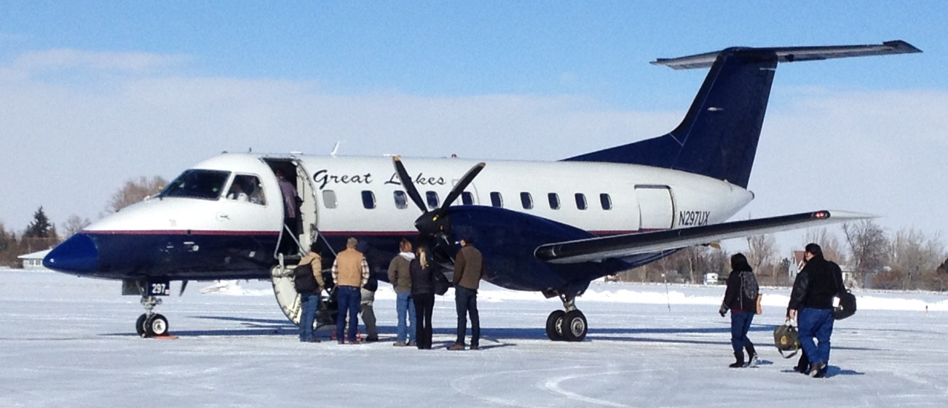
Historical Provider

Slide 7
Sheridan/Johnson County Solution
Community “Need” was established- Reliability
CAST formed – prior to cessation of service to affect reliability and options.
Specific, focused recruitment effort for carrier and funding.
Unique Collective effort to aggregate public and private concerns around air service
Social cost of no service.
Notes:
Reliable Service was echoed at every meeting. This drove the formation of CAST Early

Slide 8
Community Need – Goal Reliable Air Service
Sheridan had history of commercial service – expectation to continue.
Demonstrated use during mid 2005-2008 to support service.
Tourism, Longmire Days, Dude Ranches
Impact to Sheridan and Johnson County – via zip code statistics – Leakage to MT
Infrastructure funding for Sheridan County Airport.
Notes:
Expectation – thus folks need to pony up
Customer Loads were not “pie in the sky” but reachable /attainable goals

Slide 9
Economic Drivers - Sustainability
Sustainability and Retention of existing employers
Health Care (Sheridan Memorial, VAMC, VOA)
Banking – Audits/Training
Telecon- Marketing/Training
Extractive Industry - Operations
Education – Recruitment/Training
Notes:
Business Costs that may not be apparent but are clearly in the picture for sustainability

Slide 10
Economic Drivers - Community
Recruitment and Promotion of business
Business Real Estate and Parks
Site Selectors - requirement
Expansion- on the ground due diligence
Funding – on the ground due diligence
Notes:
City /County Gov’t Investments

Slide 11
Community Solution
Critical Air Service Team Established
Multiple industry sectors
Public sector
State of Wyoming – Aeronautics Board
RESULT:
Collaborative effort
Ability to establish constituency – critical mass
Additional market strength
Notes:
Two Communities

Slide 12
Community Time Line
2013 – Meetings with Great Lakes Airlines at Cheyenne and Sheridan to affect service – issues with reliability
Inquire and aggregate “leakage data” – significant loss to Billings Airport (>83%)
2014 – CAST took active role in seeking partners – United, Delta, Skywest, American.
2015 – GL ceased service on April 1, 2015

Slide 13
Urgency
Cessation of service
Community recognized vital nature
Fed TSA capacity was impacted – loss of security and 6 jobs
Airport infrastructure funding – will be forfeited due to lack of use.
WORLAND LOSES SERVICE FEB 10
Notes:
Note County 23 Results by Schilling
Note Worland News

Slide 14
Denver Air Connection

Slide 15
Denver Air Connection
Initial Meeting convened by Wy DOT Aeronautics Division in June of 2015
Unique position as a “charter carrier”
Operated passenger route from Centennial to Grand Junction
Open to discussion for Sheridan Service
Wy DOT and Forecast generated preliminary cost pro-forma
Notes:
CAST had met with several carriers on our own nicke

Slide 16
Feasibility of DAC
Ability to Serve
Type
Frequency
Location
Financial Assurances and Contracting
Sheridan County Airport Functions
Market

Slide 17
Deal Characteristics
Ability to Serve - Centennial to Grand Junction as Model
Community CAST - Used Cody Template for organization.
WyDOT Data on Market and Costs
Shortfall on anticipated traffic – DAC required Minimum Revenue Guarantee – No At Risk
Start Date - DAC, DIA, Sheridan
Notes:
DAC can carry passengers
CAST is organized
Cody and JH worked

Slide 18
Funding Assurances
WyDOT /DAC pro-forma on costs demonstrated a need for $2.8 M – this value was estimate based on historical loading.
Wyoming has many airports with some revenue guarantee
Cost pro-forma based on 2X flights per day 6 days per week to Denver International.
Fuel and Flight Time estimated

Slide 19
Source of Funds
Sheridan County Airport applied and received FAA Essential Air Service Grant for 500K
Sheridan /Johnson County committed 700K of funds with an understanding of private contributions of 310K.
$1.68 State of WY Aeronautics
Sheridan/Johnson County funds apportioned by population.
Sheridan County Airport waived some operational fees.

Slide 20
Contracting Details
DAC/CAST signed contract September 23, 2015
Service, 30 Passenger Jet initiated Nov 19, 2015.
2X Flights per day 6 days per week + 1 flight Sunday
Community Driven Marketing

Slide 22
Marketing of Service
Via Contract – CAST has responsibility to market the service.
Ability to “affect” pricing.
Pro-Active committee focused with Tourism and Chamber expertise.
Secured shared funding from STT/WYDOT for initial funding to implement media campaign
Is on going effort

Slide 23
Impacts of Commercial Air Service
Airport Function and FAA Funding
Jobs Created -
Collaboration with Sheridan /Johnson County on funds, marketing, and passengers
Collaboration with WYDOT
Market
Costing
Value

Slide 24
Results as of Jan 31, 2016
Initiated Service Nov 19
Total Flights Scheduled = 293 (Jan 31)
Total Flights ‘on Time” = 291 (Jan 31)
Dec 589 from Sheridan
January 521 from Sheridan
Currently about 40% traffic is business. (n=106)
Two flights canceled by ATC in Denver - Snow
Cost of operations 3890/4990 = ~ 80%
TSA /Security is challenge
Notes:
Data is from FAA and customer survey
We are benefit from low fuel prices.

Slide 25
Maintaining Service
Increase customer base to match operating costs. This, today, is about $3900, per flight.
Maintain DAC performance record.
Passenger Safety/TSA
Baggage agreements – Code Share
Adequate, assured funding if needed.

Slide 26
Summary
Wyoming is not a “viable” commercial market based on demographics.
Commuter Air Service is starved for pilots and inventory.
New options need to be consider
Revenue is only part of the business decision.
Commercial air service enables connectivity

